Slide 1
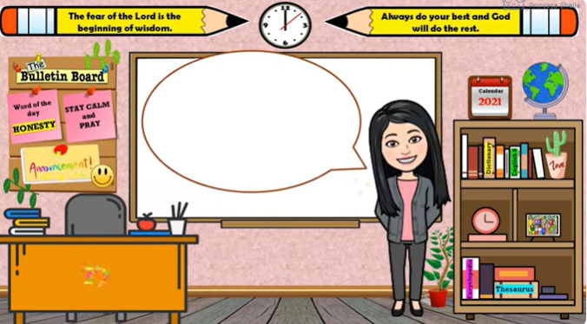
ELEMENTS
OF A PLOT IN A
STORY

Slide 2
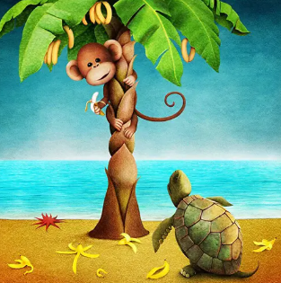
ACTIVITY 1:
IN 5 MINUTES, ARRANGE THE EVENTS IN THE STORY “THE MONKEY AND THE TURTLE” IN ORDER
OF OCCURRENCE.
Use letters A-E.

Slide 3

1) Seeing the turtle’s tree full of bananas, the greedy monkey
climbed up and refused to share the fruits.
2) The turtle carefully planted her half, which grew strong and bore fruit,
while the monkey’s half withered and died.
3) In the end, the turtle enjoyed the fruits of her patience and
wisdom, while the monkey suffered the consequences of his greed.
4) One sunny afternoon, on their journey through the forest, a monkey
and a turtle found a banana tree and decided to divide it, with the
monkey taking the upper half and the turtle the lower half.
5) The clever turtle devised a plan and outsmarted the monkey to
make him pay for his selfishness.

Slide 4
1) Seeing the turtle’s tree full of bananas, the greedy monkey
climbed up and refused to share the fruits. (C )
2) The turtle carefully planted her half, which grew strong and bore fruit,
while the monkey’s half withered and died. (B)
3) In the end, the turtle enjoyed the fruits of her patience and
wisdom, while the monkey suffered the consequences of his greed. (E)
4) One sunny afternoon, on their journey through the forest, a monkey
and a turtle found a banana tree and decided to divide it, with the
monkey taking the upper half and the turtle the lower half. (A)
5) The clever turtle devised a plan and outsmarted the monkey to
make him pay for his selfishness. (D)

Slide 5
One sunny afternoon, on their journey through the forest, a monkey
and a turtle found a banana tree and decided to divide it, with the
monkey taking the upper half and the turtle the lower half.
The turtle carefully planted her half, which grew strong and bore fruit,
while the monkey’s half withered and died.
Seeing the turtle’s tree full of bananas, the greedy monkey
climbed up and refused to share the fruits
The clever turtle devised a plan and outsmarted the monkey to
make him pay for his selfishness.
In the end, the turtle enjoyed the fruits of her patience and wisdom,
while the monkey suffered the consequences of his greed.

Slide 6
LEARNING OBJECTIVES:
describe
the
parts of the
plot;
2. analyze how each part of the plot contributes to the development of the story and its events;
3. organize the events in the
story and explain how the sequence helps convey the story’s message.

Slide 7


WHAT IS PLOT?

Slide 8
The plot is the organized chain of actions and incidents that forms the core structure of a narrative/story.
It answers the critical questions: What happens in the story, and in what order?
The plot establishes the causality, showing why events occur and how characters react and change.

Slide 9
WHAT ARE THE ELEMENTS OF A PLOT?

Slide 10
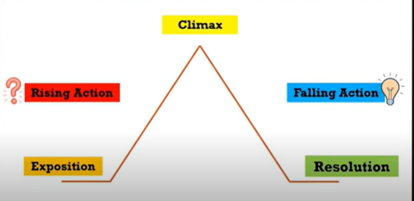
ELEMENTS/PARTS OF A PLOT IN A STORY

Slide 11
ELEMENTS/PARTS OF A PLOT IN A STORY
  The exposition is the foundational element, providing necessary context before the action begins.
  Reveals the main characters and the primary setting (time and place).
  Sets the initial mood and prepares the
audience for the coming narrative journey.

Slide 12
Rising Action: Building Conflict
  Inciting Incident-The event that disrupts the peace and introduces the central conflict.
  A series of events and complications that increase tension and make the resolution more difficult.
  Characters respond to these events,
revealing their motivations, strengths, and
flaws.

Slide 13
Climax: The Turning Point
  The Climax is the decisive moment where the main conflict comes to a head. It is the most dramatic and suspenseful event of the entire story.
  Emotional intensity and uncertainty about the outcome are at their maximum
  The protagonist makes a critical decision or takes action that permanently alters their situation.

Slide 14
  Falling Action
  shows the logical results of the climactic decisions, ensuring all plot elements are accounted for before the conclusion.

Slide 15
  The resolution, or Dénouement, is the story’s conclusion. The conflict is settled, and a new stable condition is established for the characters.
  New Norm: Characters often return to a new state of being, changed by the events of the plot.

Slide 16
Q AND A
  Why plot matters?
A well-structured plot ensures tension builds effectively, keeping the audience invested in the outcome.
The plot forces characters to overcome obstacles, leading to meaningful development and revelation of themes.
Plot provides the essential roadmap, preventing the story from feeling aimless or confusing.

Slide 17
FINAL OUTPUT
TECHNIQUES IN WRITING A STORY
Use the 5Ws (Who, When, What, Where, Why) – Start your story by answering these questions to set a clear foundation.
Follow the Plot Pyramid (Beginning, Middle, End) – Keep it simple with exposition, conflict, climax, and resolution.
Show, Don’t Just Tell – Instead of saying “Maria was sad,” write “Tears rolled down Maria’s cheeks as she hugged her notebook.”

Slide 18
FINAL OUTPUT
TECHNIQUES IN WRITING A STORY
Use Dialogue – Let characters talk; it makes the story more alive and realistic.
Keep Characters Simple – Focus on 1–2 main characters so the story is easier to follow.
Add a Twist – Surprise the reader with something unexpected near the climax (but still believable).

Slide 19
FINAL OUTPUT
TECHNIQUES IN WRITING A STORY
Write in Short Paragraphs – Makes the story clearer and less overwhelming to read.
Think of a Moral or Theme – Decide what lesson or message your story should leave behind.
Examples:
Friendship, honesty, perseverance, kindness, family, respect, greed, hope, contentment vs greed, etc.
Reflect Filipino values, culture, local, or national identity in your story.
Think of a Meaningful and interesting title.

Slide 20
OUTPUT-Guidelines:
Criteria:
Output Quality 5 pts.
-neatness
-legibility
-paper management
2. Content Quality 10 pts.
-well organized/sequenced
-complete plot elements
-no grammatical, spelling, punctuation,
capitalization errors
3. Adherence to the guidelines 5 pts.
Note: (1 point deduction for every failure to adhere
with the guidelines and criteria.)
  One page hand written fable in 1 short bond paper, w/ 5 paragraphs
  Include borders
  With Catchy Title
  Include some theme related designs
  Make sure your fable reflects moral/values.
  Indicate the moral/lesson of your story at the bottom.
  Submission: August 3, 2026

Slide 21
Activity 2: Arrange the Events
Directions: Number the following events from 1–5 according to the order in which they happened in the story. Write 1 for the first event and 5 for the last event.
___ The poor family shared their collected money with everyone in the
courtroom after the judge's decision.
___ The wealthy neighbor accused the poor family of enjoying the aroma of his
food without paying for it.
___ The judge asked the father to shake the coins so the wealthy man could
hear their sound.
___ The father and his children lived happily despite being poor and often
laughed and played together.
___ The judge ruled that the sound of the coins was fair payment for the smell of
the rich man's food.

Slide 22
Activity: Arrange the Events (Answer Key)
Directions: Number the following events from 1–5 according to the order in which they happened in the story. Write 1 for the first event and 5 for the last event.
The father and his children lived happily despite being poor and often laughed and played together.
The wealthy neighbor accused the poor family of enjoying the aroma of his food without paying for it.
The judge asked the father to shake the coins so the wealthy man could hear their sound.
The judge ruled that the sound of the coins was fair payment for the smell of the rich man's food.
The poor family shared their collected money with everyone in the courtroom after the judge's decision.

Slide 23
OUTPUT
______________________
_________________
Title
_____________________________________________________________________________________________________________________________________________________________________________________________________________________________________________________________________________________________________________
Moral of the Story:
___________________________________________
________________
Parent Signature

Slide 24
Story Writing Rubric: Elements of a Plot

